Slide 1
Data Inceptionists
Frank Liu, Ryan Cambell

Slide 2
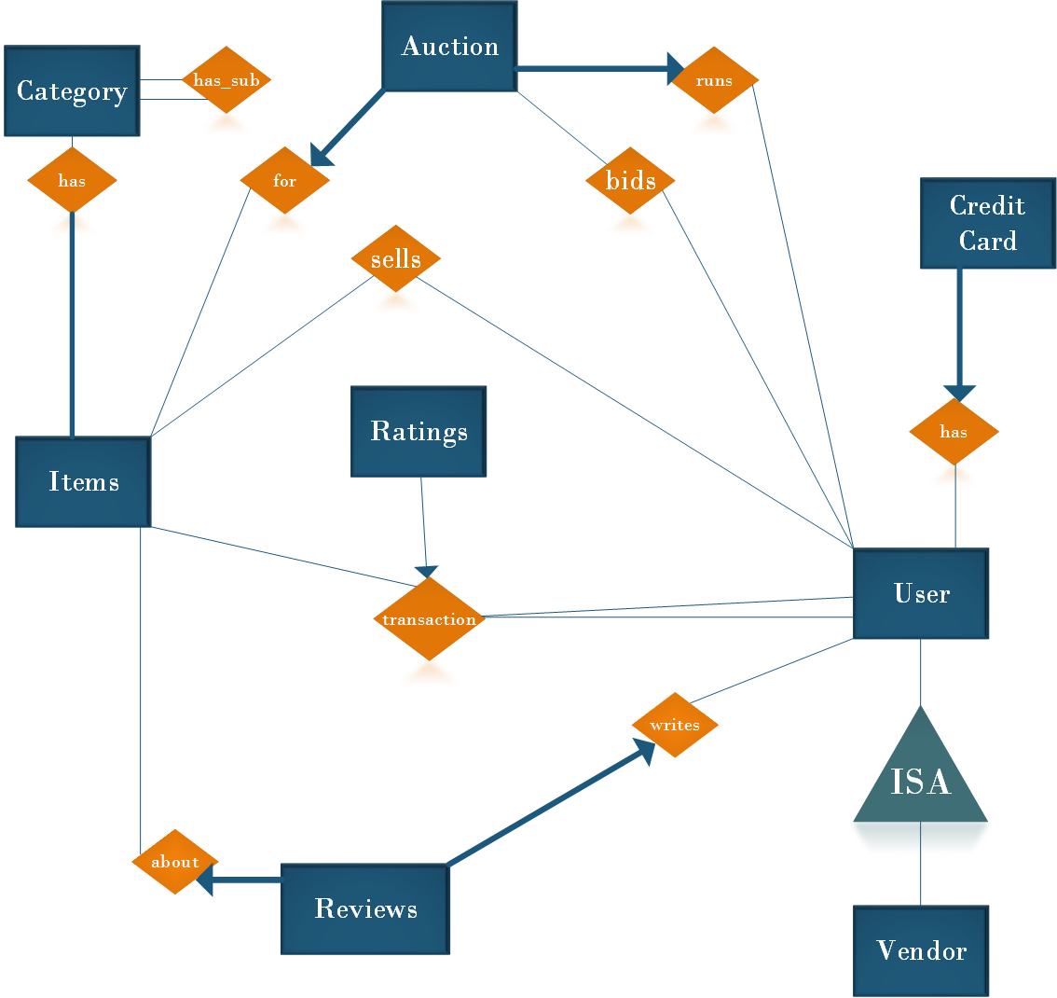
Overview

Slide 3
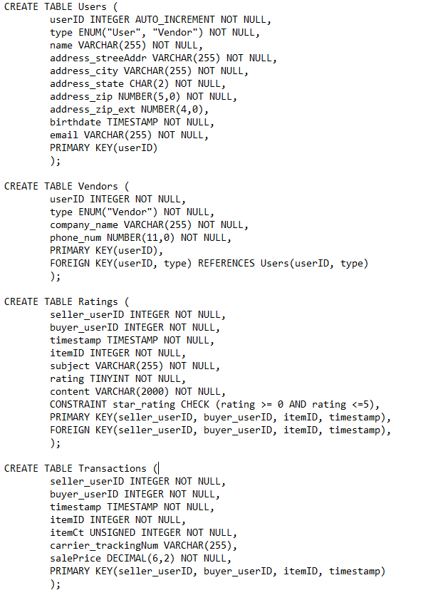
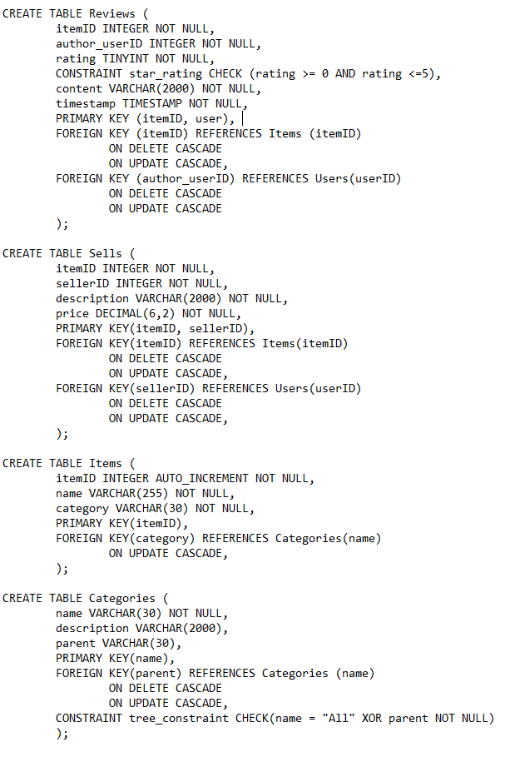
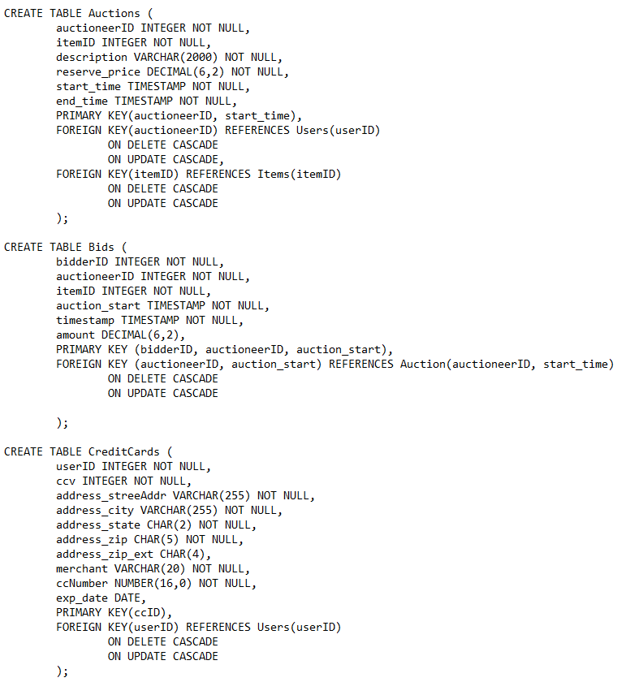
Final Schema

Slide 4
User Types

Slide 5
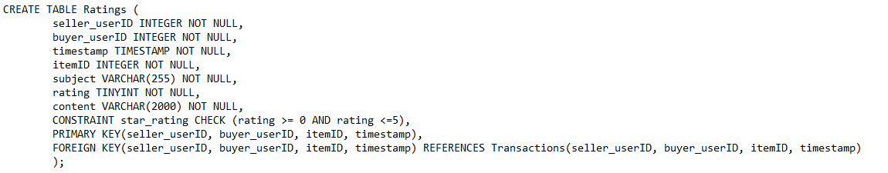
Reviews/Ratings

Slide 6
Items and their Categories

Slide 7
Auctions and Bids

Slide 8
Credit Cards

